Slide 1
COMPONENT, DEPLOYMENT AND PACKAGE UML DIAGRAMS
Laila R
2022503538

Slide 2
COMPONENT DIAGRAM
A component diagram, a type of structural UML diagram is used to break down a large object-oriented system into the smaller components, so as to make them more manageable.
It models the physical view of a system such as executables, files, libraries, etc. that resides within the node.
The main purpose of the component diagram are enlisted below:
It envisions each component of a system.
It constructs the executable by incorporating forward and reverse engineering.
It depicts the relationships and organization of components.

Slide 3
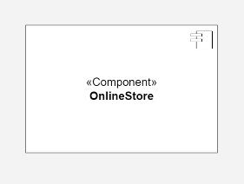
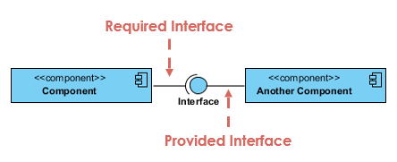
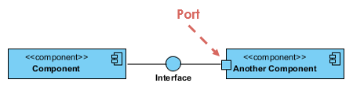
NOTATIONS OF A COMPONENT DIAGRAM
COMPONENT
Represent modular parts of the system that encapsulate functionalities. Components can be software classes, collections of classes, or subsystems.
INTERFACES
Specify a set of operations that a component offers or requires, serving as a contract between the component and its environment.
PORTS
Represent specific interaction points on the boundary of a component where interfaces are provided or required.

Slide 4

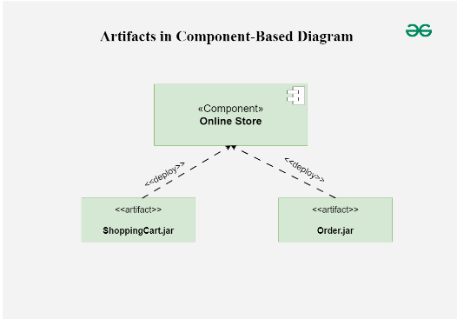

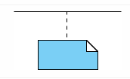


5. ARTIFACTS
Represent physical files or data that are deployed on nodes.
RELATIONSHIPS
Depict the connections and dependencies between components and references.
Composition
Aggregation
Constraint
Dependency
Link

Slide 5
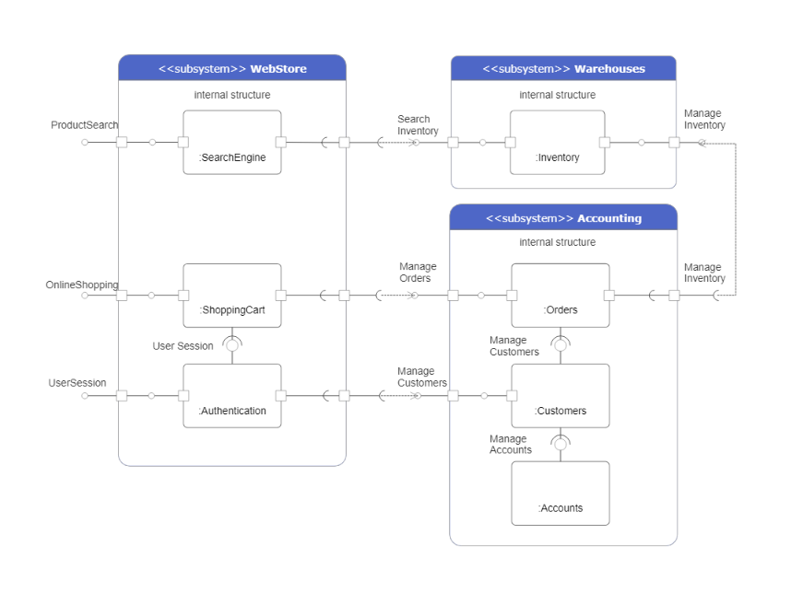
Web based E-Commerce System

Slide 6
DEPLOYMENT DIAGRAM
A UML deployment diagram is a diagram that shows the configuration of run time processing nodes and the components that live on them.
Deployment diagrams is a kind of structure diagram used in modeling the physical aspects of an object-oriented system.
Purpose of Deployment Diagrams
They show the structure of the run-time system
They capture the hardware that will be used to implement the system and the links between different items of hardware.
They model physical hardware elements and the communication paths between them

Slide 7
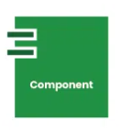
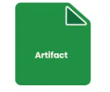
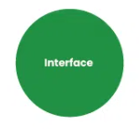
NOTATIONS OF A DEPLOYMENT DIAGRAM
COMPONENT:
A component represents a modular and reusable part of a system, typically implemented as a software module, class, or package.
ARTIFACT:
An artifact represents a physical piece of information or data that is used or produced in the software development process.
INTERFACE:
An interface defines a contract specifying the methods or operations that a component must implement.

Slide 8
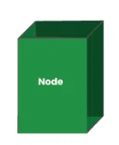
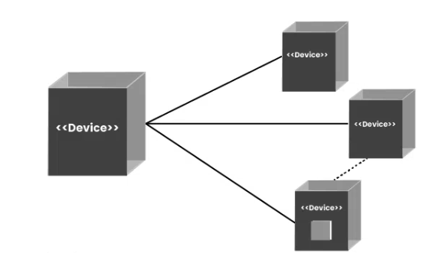
4. NODE:
A node represents a physical or computational resource, such as a hardware device, server, workstation, or computing resource, on which software components can be deployed or executed.
5. COMMUNICATION PATH:
A straight line that represents communication between two device nodes.

Slide 9
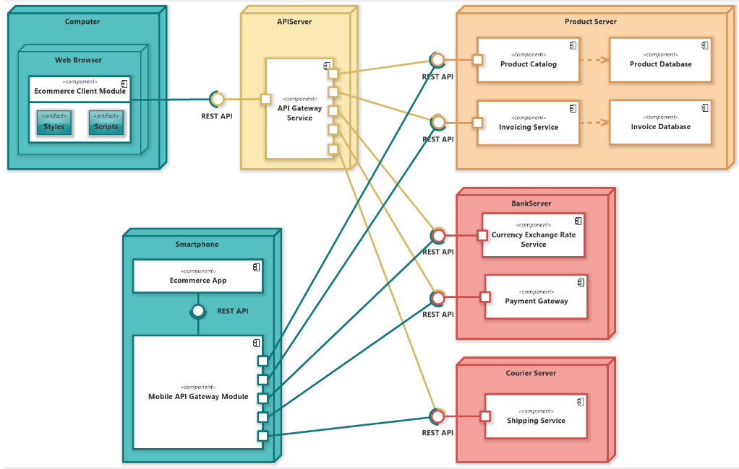
E-COMMERCE MICROSERVICES ARCHITECTURE

Slide 10
PACKAGE DIAGRAM
Package diagram, a kind of structural diagram, shows the arrangement and organization of model elements in middle to large scale project.
Package diagram can show both structure and dependencies between sub-systems or modules, showing different views of a system, for example, as multi-layered (aka multi-tiered) application - multi-layered application model.
Purpose of Package Diagrams
Package Diagram can be used to simplify complex class diagrams, it can group classes into packages.
A package is a collection of logically related UML elements.
Packages are depicted as file folders and can be used on any of the UML diagrams

Slide 11
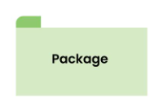
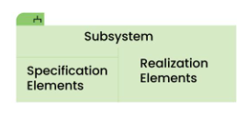
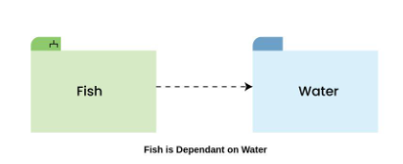
NOTATIONS OF PACKAGE DIAGRAM
PACKAGE
Basic building block of the Package Diagram
SUBSYSTEM
A subsystem represents a logically independent part of a larger system
DEPENDENCY
Dependencies are used to show that there might be some element or package
that can be dependent upon any other element or package.

Slide 12
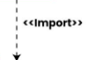

IMPORT
Used to represent the below package or function or element has been imported from the above package.
MERGE
Denotes that the Package 1 can be merged with Package 2

Slide 13
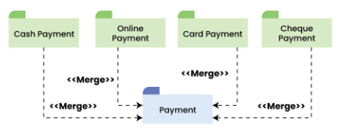
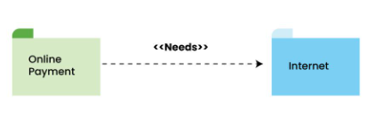
RELATIONSHIPS
Package Merge Relationship
Used to represent that the contents of a package can be merged with the contents of another package.
Package Dependency Relationship
A package can be dependent on other different packages, signifying that the source package is somehow dependent on the target package.

Slide 14
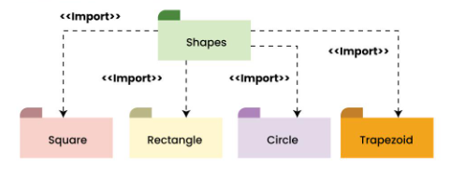
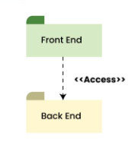
Package Import Relationship
This relationship is used to represent that a package is importing another package to use.
Package Access Relationship
This type of relationship signifies that there is a access relationship between two or more packages, meaning that one package can access the contents of another package without importing it.

Slide 15
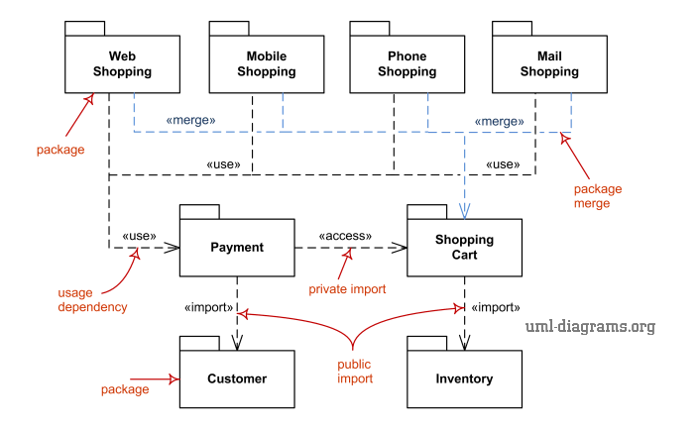
E-commerce Environment

